Slide 1

Embracing the Future of Wedding Planning: Virtual Wedding Planning Concierge
Submitted By:-
Manpreet Singh Rana (40227463)
Habeeb Dashti (40261505)
Snehil Sharma (40267285)
Arif (40269948)
@GitHub

Slide 2
Overview
In the modern digital age, couples face the daunting task of wedding planning because of their busy schedules and diverse preferences. The Virtual Wedding Planning Concierge emerges as a ground-breaking solution, transforming the chaos into a harmonious, stress-free experience by integrating cutting-edge technology with personalized planning services.
Did you know that 40% of couples categorize wedding planning as 'extremely stressful'? Imagine transforming this into an experience that's not just stress-free but delightfully memorable.

Slide 3
Project’s Relevance
Market Analysis
Market Justification
Targeting tech-savvy couples aged 25-35, our Virtual Wedding Planning Concierge addresses the growing demand for a seamless, efficient planning experience. By integrating VR/AR, real-time communication, and personalized recommendations, we're positioned to capture a significant market share in this expanding industry.
The global wedding services market is booming, with an expected growth from USD 178.46 Billion in 2022 to an unexpected scale by 2032, signaling an early opportunity for digital innovation in wedding planning.

Slide 4


Feasibility and Viability
Technical Viability: Utilizing Python for backend processes, Unity3D for VR/AR experiences, and TensorFlow for machine learning, our project is built on robust, scalable technologies. Cloud hosting on AWS ensures global accessibility and reliability.
Operational Feasibility: Our platform seamlessly integrates with existing wedding service providers, offering a comprehensive solution from planning to execution, making it operationally viable in today’s digital ecosystem.
Economic Viability: Preliminary cost estimations and revenue models suggest a break-even point within the first two years, underscored by diverse revenue streams including subscription fees, vendor commissions, and premium features.

Slide 5

Solution Highlights
Virtual Reality & Augmented Reality : Immerse in a virtual setup of your wedding venue, visualize decorations and seating arrangements in real-time, ensuring your vision comes to life exactly as imagined.
AI-driven Recommendation Systems: Personalized vendor recommendations leveraging machine learning, from catering to photography, tailored to your style and budget preferences.
In-App Communication Logs: Comprehensive tracking of all communications with vendors, ensuring transparency and accountability, with agreements secured and accessible.
Social Media Integration: Effortlessly share your wedding journey, from digital invites to day-of highlights, across social platforms, engaging friends and family in your celebration.

Slide 6
Solution Highlights
Language Localization: Bridging cultural gaps with multi-language support, enabling you and your loved ones to plan and experience your wedding in your preferred language.
Weather Forecast Integration: Receive proactive weather updates and suggestions for adjustments, ensuring your day remains perfect, regardless of the forecast.
Budget Management & Tracking: An intuitive financial planning tool that keeps your wedding expenses in check, offering visual insights into your spending and remaining budget.
Virtual Assistant for 24/7 Support: Round-the-clock assistance from an AI-powered virtual assistant, ready to provide personalized guidance and automate tasks on your behalf.

Slide 7
Project Plan Overview
Bottom-up Approach
Agile
Philosophy
Iterative development

Slide 8
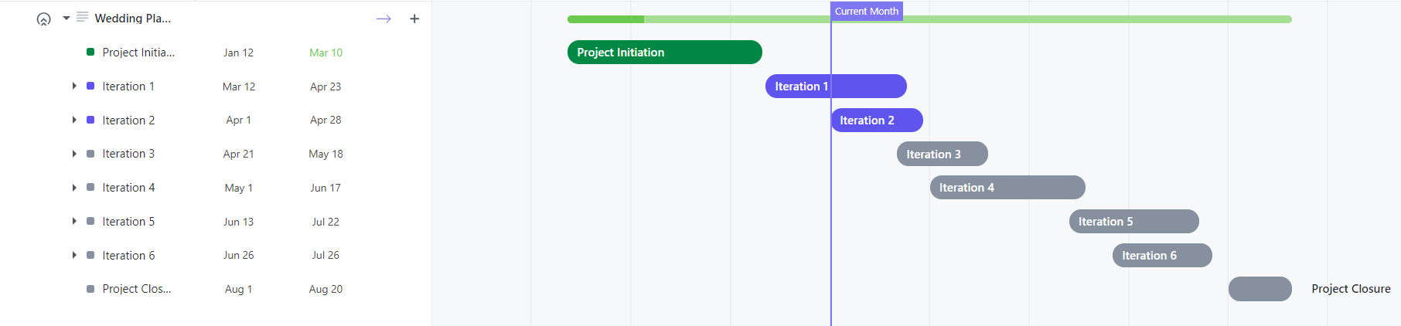
Project Timeline

Slide 9
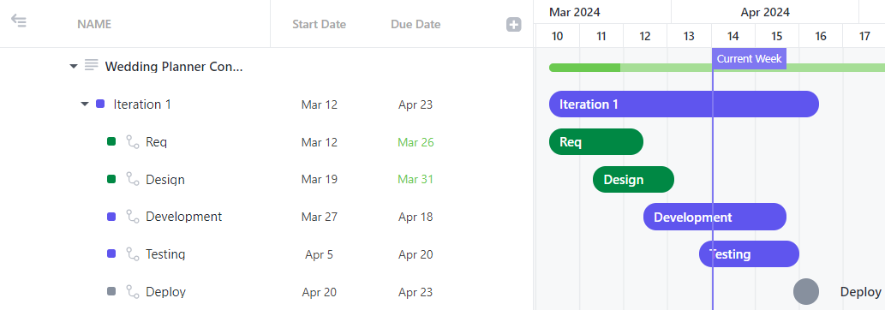
SDLC Timelines

Slide 10
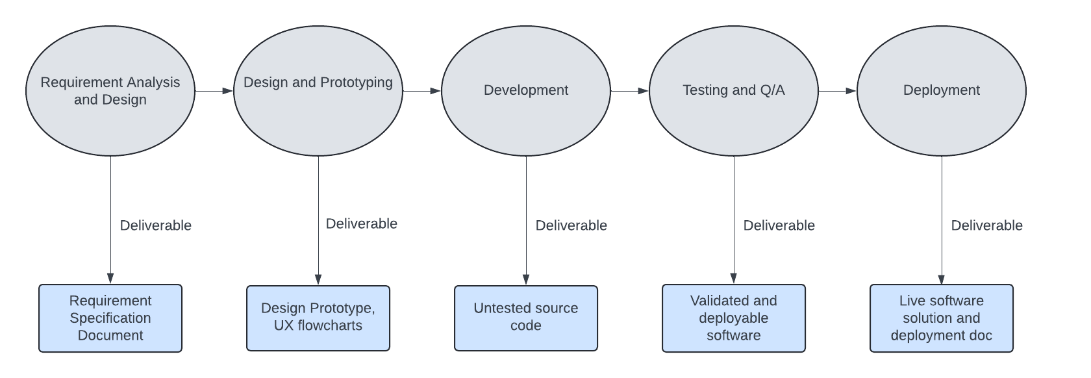
Milestones at every Iteration Phase

Slide 11
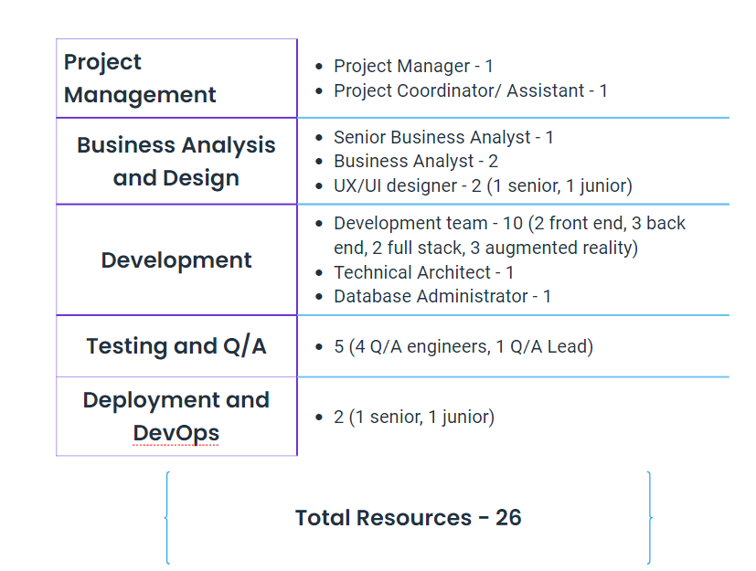
Resource Allocation

Slide 12
Risk Management
Technical Risks
Mitigation Statergy
Compatibility testing at every development stage
Collab with experienced AR/VR developers, conducting usability testing and using pre-existing frameworks
Competitive compensation package and partnerships with academic institutions to retain top talent
Compatibility Issues
Complexity of Integrating AR/VR
Availability of Skilled Developers

Slide 13
Risk Management
Investment in change management programs, comprehensive training materials, and proactive stakeholder engagement.
Implementation of robust data management protocols including encryption, access controls, and regular audits.
Operational Risks
Mitigation Strategy
Resistance to change from users and vendors from other similar online products or offline market
Data management issues such as data loss and unauthorised access

Slide 14
Risk Management
Economic Risks
Mitigation Strategy
Market fluctuations
Unexpected costs
Diversification of revenue streams.
Maintaining contingency funds.
Closely monitoring market trends.

Slide 15
Budget Overview
Cost can be broken into 4 different components
Development
Testing
Marketing
Maintenance

Slide 16
1. Development
Cost components
2. Testing
Development cost covers the software development team, technology infrastructure, external consultants, and other contingencies. The salaries of individuals involved in the development is taken care of during cost analysis.
The total cost can be determined by multiplying the number of developers and the individual cost of each of them throughout the project.
Testing cost covers the Quality Assurance(QA) Team, and tools and Environment needed for testing.
The total cost can be determined by multiplying the number of testers involved and the individual cost of each of them throughout the project. Along with this the cost of all the software tools that are needed for testing are also included in the cost analysis.

Slide 17
3. Marketing
Cost components (Contd.)
4. Maintenance
Marketing cost covers digital marketing, offline marketing and public relations (PR).
Digital marketing involves Paid Advertising, Content Marketing. Offline Marketing involves Events and Sponsorships as well as Print Materials. Public relations means Media Outreach.
Maintenance is one of the crucial aspects in any software development life cycle. It may be in terms of technical support through help desk which in turn can lead to bug fixes and updates or server maintenance which includes hosting fees and application monitoring. Budgeting includes analyzing the cost of each of these sub-components.

Slide 18
Conclusion
Our virtual wedding planning concierge service offers a comprehensive solution for couples seeking to plan their dream wedding with ease and efficiency. Through meticulous budget planning, resource allocation, and contingency management, our service ensures every aspect of the wedding, receives the attention it deserves while staying within budget. With the convenience of virtual collaboration and expert guidance, couples can navigate the wedding planning process seamlessly, leading to a memorable and stress-free wedding experience.
For stakeholders interested in enhancing their wedding planning experience, we invite them to delve deeper into our virtual wedding planning concierge service. Let's embark on this thrilling journey together, ensuring your special day exceeds all expectations.

Slide 19

Thank You

